Slide 1


Slide 2

Add School Name

Slide 3

Add information

Slide 4

Add information

Slide 5
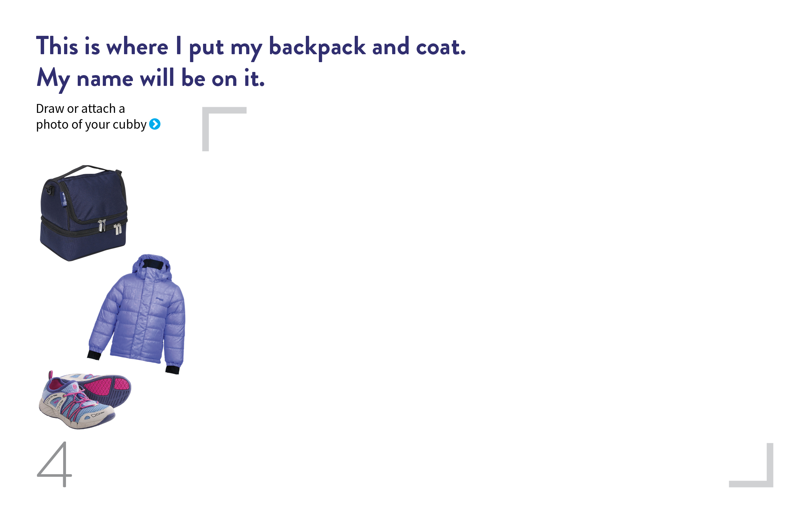

Slide 6


Slide 7
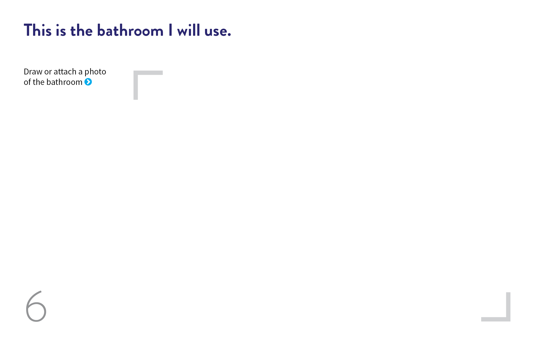

Slide 8


Slide 9


Slide 10


Slide 11


Slide 12


Slide 13

Add information

